Slide 1


Reactions with deuterons within the CDCC formalism
Neelam J. Upadhyay & Filomena Nunes
Michigan State University
In collaboration with: A. Deltuva
TORUS
COLLABORATION

Slide 2
Preface
The Continuum Discretized Coupled Channel Method (CDCC):
    Well established theory for breakup reactions.
    Includes breakup to all orders but assumes breakup-transfer couplings are small.
Faddeev Approach:
    Explicitly includes breakup and transfer channels to all orders.
Is Ψ^{CDCC} good representation of full 3-body wave function to calculate the transfer
matrix element?
What are the limitations of the CDCC method?
Aim of this work: To seek answer to these questions.

Slide 3





CDCC Method
Schrödinger Equation:
where,
U_{nT}: neutron-target optical potential
U_{pT}: proton-target optical potential
V_{pn}: proton-neutron binding potential
The CDCC wave function, Ψ^{CDCC} is
expanded in terms of bound & continuum
states of a given pair subsystem, as
with
φ
p
R
^{Target}
r
ψ
n
Discretized
Continuum states
Breakup Continuum
φ
∑_{α}φ _{α}
ε_{max}
ε_{max}
….
Threshold
p_{1/2}
p_{3/2}
….
s_{1/2}
(Ground state)

Slide 4
Transfer Matrix Element:
Remnant
p
p
R
^{Target}
R_{f}
r
^{Target}
n
n
r_{f}
Entrance Channel
Exit Channel

Slide 5
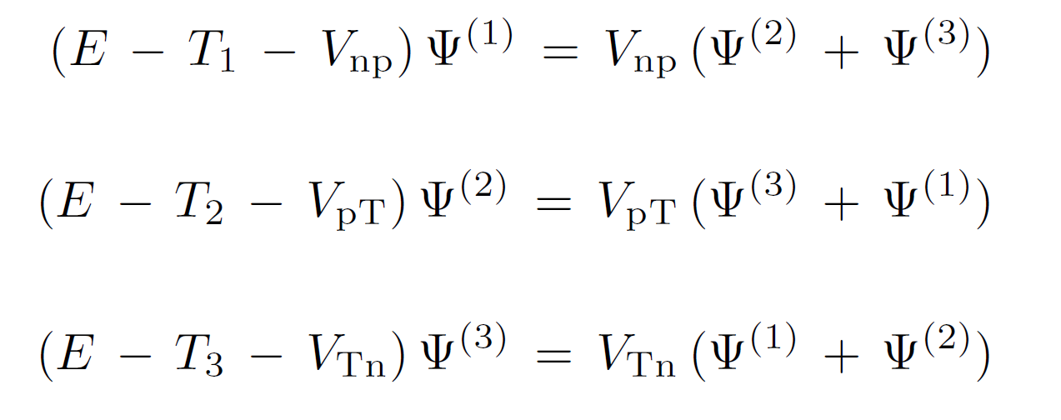
Faddeev Formalism
(1)
(2)
(3)
p
p
R₂
p
r₃
R₁
^{Target}
^{Target}
^{Target}
r₁
n
n
r₂
n
R₃
Few examples, where the formalism is used to study (d,p) reactions:
A. Deltuva, A. M. Moro, E. Cravo, F. M. Nunes, & A. C. Fonseca, Phys. Rev. C76, 064602 (2007).
A. Deltuva & A. C. Fonseca, Phys. Rev. C79, 014606 (2009).
A. Deltuva, Phys. Rev. C79, 021602 (2009).

Slide 6

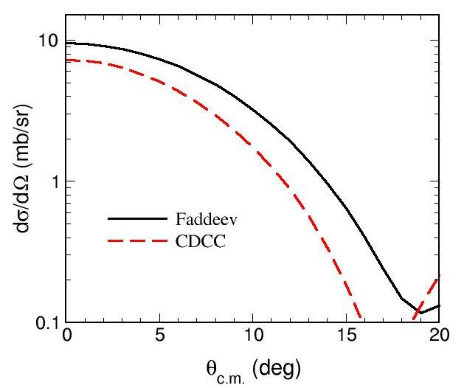
CDCC v/s Faddeev
Ref.: A. Deltuva, A. M. Moro, E. Cravo, F. M. Nunes, & A. C. Fonseca, PRC76, 064602 (2007).
Studied for three reactions:
  d + ¹²C @ E_{d} = 56 MeV (elastic & breakup observables)
  d + ⁵⁸ Ni @ E_{d} = 80 MeV (elastic & breakup observables)
  p + ¹¹Be @ E_{11Be} = 38.4 MeV/A (elastic, breakup & transfer observables)
CDCC in agreement with Faddeev!
Transfer cross section
For breakup & transfer:
CDCC underestimates Faddeev!
Calls for better understanding of
limits of CDCC methods.

Slide 7
Our Approach
We start with studying (d, p) reactions on ¹⁰Be, as a function of beam energy.
Compare CDCC and Faddeev calculations starting from the same 3-body Hamiltonian.
In this talk, calculations for the reaction of deuteron on ¹⁰Be are presented at
    E_{d} = 21.4 MeV (Data from ORNL [under analysis])
    E_{d} = 40.9 MeV (Data from GANIL [NPA683, 48 (2001)])
    E_{d} = 71 MeV

Slide 8

Inputs to 3-body Hamiltonian
CDCC calculations are performed using deuteron breakup states.
Potentials:
  For neutron-proton (n-p) bound & continuum states:
  A Gaussian Potential
  where, V₀ = 72.15 MeV and r₀ = 1.484 fm
  Optical potentials:
  Chapel-Hill Global Parameterization (spin-orbit neglected)
  n-¹⁰Be binding potential: V = 57.07 MeV, r = 1.25 fm, a = 0.65 fm
The interactions between all pairs are spin independent.
Model space convergence is checked.

Slide 9
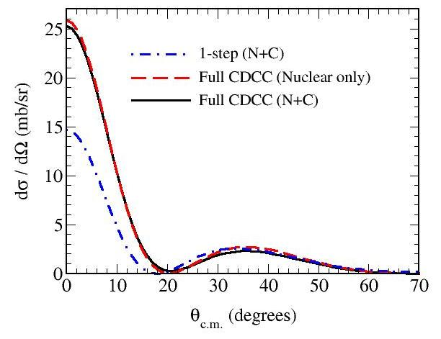
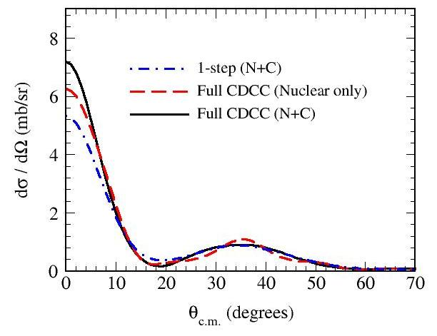
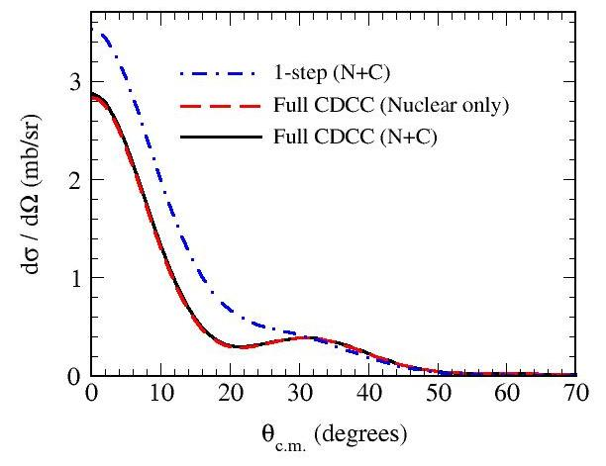
Transfer Cross section
¹⁰Be + d → ¹¹Be + p
E_{d} = 21.4 MeV
E_{d} = 40.9 MeV
Results indicate that:
Coulomb effects are significant in angular distributions
for θ < 10º.
Continuum has strong influence on Transfer process.
E_{d} = 71 MeV

Slide 10
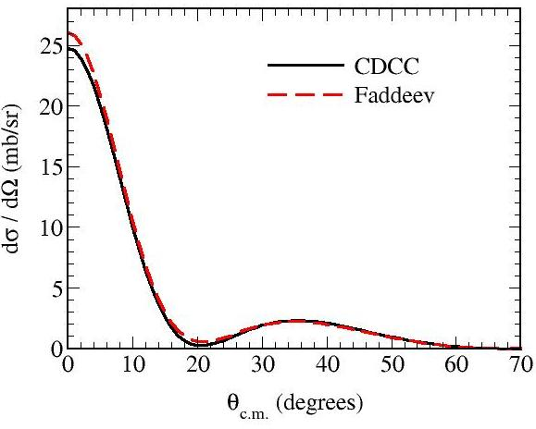
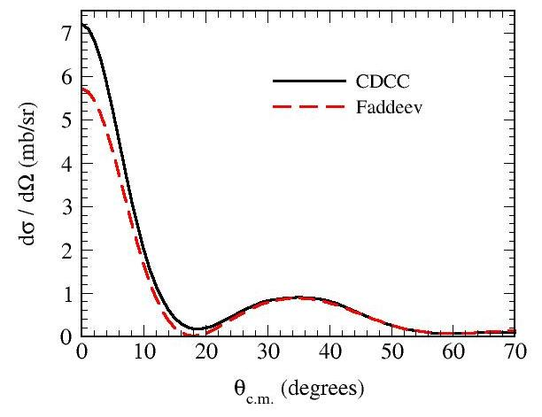
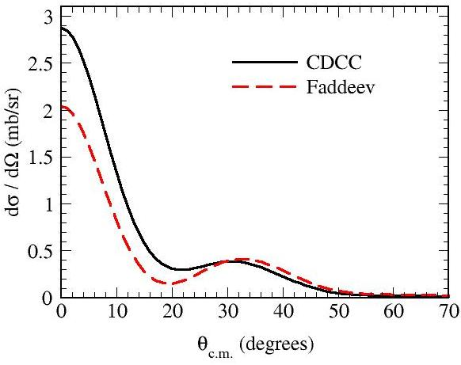
Comparing CDCC with Faddeev
¹⁰Be + d → ¹¹Be + p
Estimate of discrepancy in two methods
E_{d} | Δ(CDCC-FAD)_{θ = 0}º
21.4 MeV | 5.12%
40.9 MeV | −20.72 %
71 MeV | −29.06%
E_{d} = 21.4 MeV
E_{d} = 40.9 MeV
E_{d} = 71 MeV

Slide 11
Conclusions
Comparison of CDCC with Faddeev:
    At low energy, i.e., E_{d} = 21.4 MeV, we get better agreement.
    Discrepancy in two methods increases with beam energy.
Study for other cases is in progress.

Slide 12
Thank You!
My Audience
Ian Thompson (LLNL, USA)

Slide 13
Converged CDCC Model Space
E_{d} = 21.4 MeV & 40.9 MeV
Partial waves for p-n relative motion: l_{max} ≤ 4
Maximum excitation energy in the continuum: E_{max} = 17 MeV (E_{d} = 21.4 MeV)
E_{max} = 29.1 MeV (E_{d} = 40.9 MeV)
Coupled equations are integrated up to R_{max} = 60 fm with total angular momentum, J_{max} = 40
Multipoles Q ≤ 4 are included for the CDCC coupling potentials.
E_{d} = 71 MeV
Partial waves for p-n relative motion: l_{max} ≤ 4
Maximum excitation energy in the continuum: E_{max} = 40.1 MeV
Coupled equations are integrated up to R_{max} = 60 fm with total angular momentum, J_{max} = 50
Multipoles Q ≤ 6 are included for the CDCC coupling potentials.

Slide 14
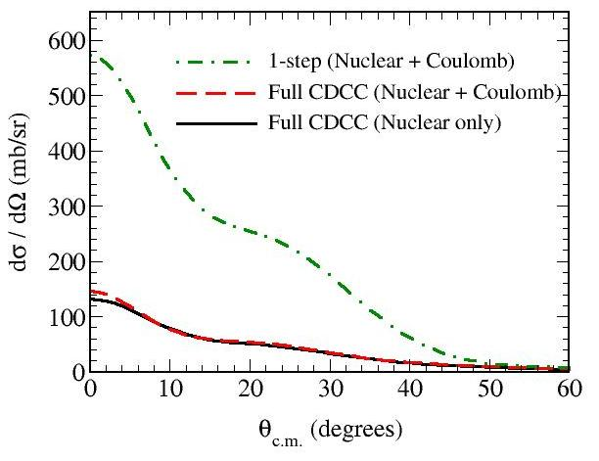
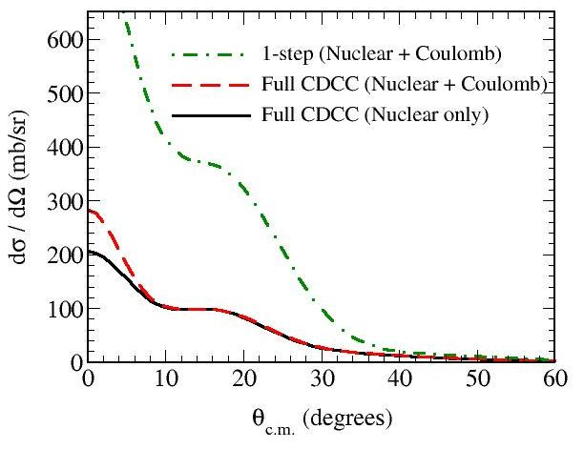
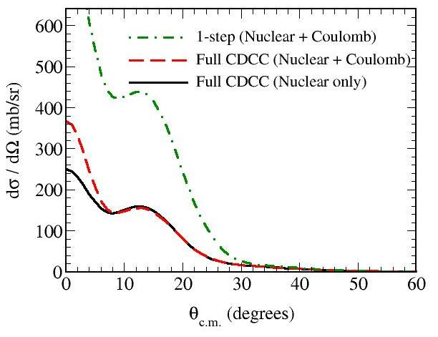
Breakup Cross section
¹⁰Be + d → ¹⁰Be + p + n
E_{d} = 21.4 MeV
E_{d} = 40.9 MeV
E_{d} = 71 MeV

Slide 15
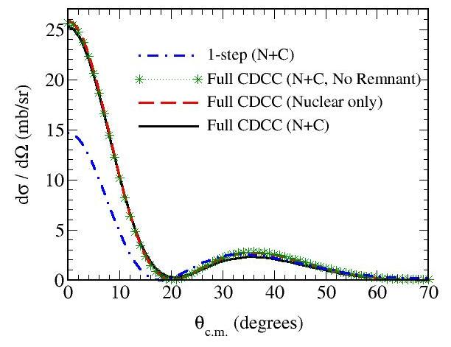
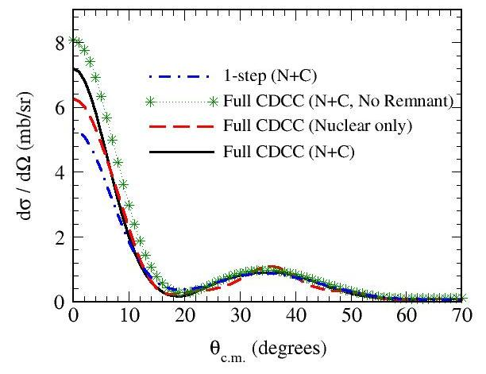
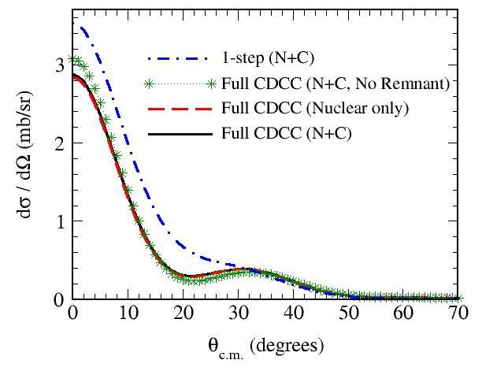
Transfer Cross section
¹⁰Be + d → ¹¹Be + p
E_{d} = 21.4 MeV
E_{d} = 40.9 MeV
E_{d} = 71 MeV

Slide 16
Interaction details for Faddeev
n-T optical potentials are l-dependent:
  It is a Binding potential for l = 0.
  It is a Chapel Hill -89 global parameterization for l ≠ 0.
p-T optical potentials can be calculated at energy E_{p} in the exit channel or (E_{d}/2) in the entrance channel.

