Slide 1


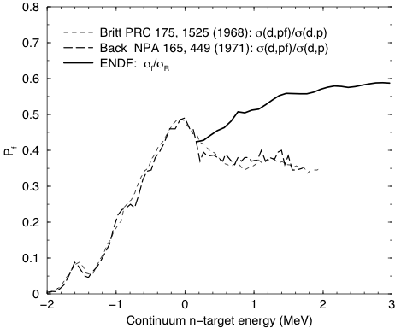
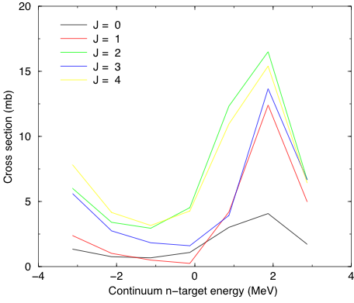
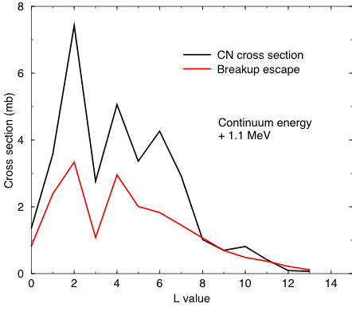
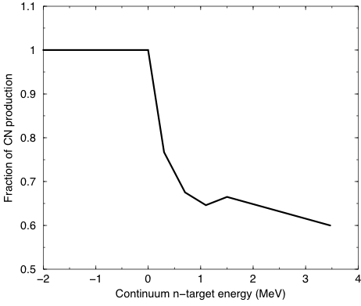
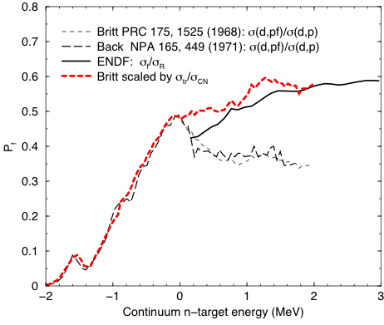
The Theory of Partial Fusion
I.J. Thompson Nuclear Theory and Modeling, Lawrence Livermore National Laboratory, CA 94551, U.S.A.
A theory of partial fusion is used to calculate the competition between escape (breakup) and absorption (compound-nucleus production) following a deuteron-induced transfer of one neutron to a heavy nucleus at energies above the neutron escape threshold
The Problem:
Arises when there is a simultaneous absorption of one part of a composite system and the need for quantum-mechanical scattering amplitudes for another part.
A theoretical model of few-body dynamics needs to be able to distinguish complete and no fusion from incomplete fusion. We need, after absorption of one fragment, to follow still the evolution of remaining part(s), in order to see whether it escapes (yielding incomplete fusion) or fuses with the target (yielding complete fusion). When it may escape, we want to predict its angular scattering amplitudes.
Example:
Using fission probabilities from ²³⁹Pu(d,pf), for example, does not give correct (n,f) cross sections if it was assumed [1] that all (d,p) transfer reactions lead to compound nucleus formation. We find that the results can differ by up to 40% even at 2 MeV of equivalent neutron energy:
This is precisely the kind and direction of difference we find with a theory of partial fusion: The observed σ(d,p) rate includes escape (breakup) as well as absorption (compound-nucleus production), so the denominator in σ(d,pf)/σ(d,p) is too large.
Theories Proposed to Predict both Outcomes:
There have been attempts to extend reaction theory to describe more general outcomes: by Udagawa & Tamura [2], of Kerman & McVoy [3] (based on [4]), and of Baur & Trautman [5], as well as a proposal of my own [6], but these give different results [7]
Theory Used:
Now follow the theory of Austern [8] that sums over the final states of just one (neutron) particle of a few-body system (eg. deuteron), and show how partial sums of the cross sections to those states can be expressed as integrals of the imaginary component of that particle’s optical potential. In this derivation we need not make any first-order approximations in the entrance channel wave functions, and can ensure post-prior equivalence for the transfer matrix elements.
References
[1] H.C. Britt et al, Phys. Rev. C 175 (1968) 1525; B.B. Back et al, Nucl. Phys. A165 (1971) 449
[2] T. Udagawa and T. Tamura, Phys. Rev. Letts. 45 (1981), 1311; Phys. Rev. C 24 (1981), 1348.
[3] A.K. Kerman and K.W. McVoy, Ann. of Phys. 122 (1979) 197
[4] M. Kawai, A.K. Kerman, and K.W. McVoy, Ann. of Phys. 75 (1973) 156
[5] G. Baur, F. Rosel, D. Trautmann and R. Shyam, Phys. Rep. 111 (1984), 333
[6] I.J. Thompson and A. Diaz-Torres, Prog. Theo. Phys. Suppl. 154, 69 (2004)
[7] A. Diaz-Torres, Phys. Rev. C 81 (2010), 041603
[8] N. Austern, et al, Phys. Rep. 154 (1987) 125.
[9] W. E. Parker et al., Phys. Rev. C 52 (1995) 252
[10] F.S. Dietrich, AIP Conference Proceedings 1005 (2008) 125.
Calculations:
Normal (d,p) formalism:
T_{dp} = < ψ⁽⁻⁾(r_{p}) φ(r_{n}) | V | ϕ_{d}(r ) ψ⁽⁺⁾(R) >
where φ(r_{n}): neutron final state in real potential.
ϕ_{d}(r ) ψ⁽⁺⁾(R): incoming deuteron wave function
V = transfer interaction (post or prior)
Now:
Neutron is in a complex potential V(r_{n})-iW(r_{n})
The -iW(r_{n}) describes the loss of flux to CN resonances,
= spreading into CN resonances
= fusion cross section = reaction cross section
So make ‘proton bin’ ξ⁽⁻⁾(r_{p}; k_{p}) from averaging the proton outgoing waves
And solve inhomogeneous eqn with source term:
[H_{n}-E_{n}] ψ_{n}(r_{n}; k_{p}) = <ξ⁽⁻⁾(r_{p}; k_{p}) | V | ϕ_{d}(r ) ψ⁽⁺⁾(R)>
The CN production cross section is
σ_{CN}(k_{p}) ≈ < ψ_{n}(r_{n}; k_{p}) | W(r_{n}) | ψ_{n}(r_{n}; k_{p}) >
Results:
First results, for exit cross sections integrated over all proton angles:
These new calculations for the competition between escape (breakup) and compound nucleus formation (absorption) agree qualitatively with results for (n,γ) reaction models [9,10].
Fission probabilities for neutrons incident on ²³⁹Pu:
Comparison of
two surrogate experiments
With evaluated ENDF/B.VII
(ratio of fission cross section
to reaction cross section)
Energy scale is
excitation energy in ²⁴⁰ Pu*.
d + ²³⁹Pu ➔ p + ²⁴⁰Pu* at E_{d} = 15 MeV
CN production cross sections
Breakup compared with CN production
CN production fraction
Corrected Fission Probabilities
This work was performed under the auspices of the U.S. Department of Energy by Lawrence Livermore National Laboratory under Contract DE-AC52-07NA27344.
LLNL-POST-439101

