Slide 1

Status of reaction theory for studying rare isotopes
Filomena Nunes
Michigan State University
HITES, June 2012

Slide 2
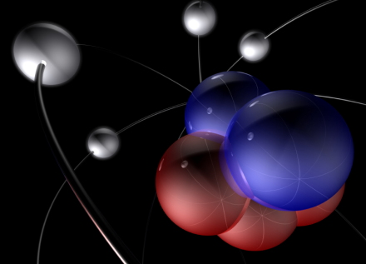
what are we after?
Unified description of nuclei and their reactions
Why is matter stable?
Effective NN force?
Limits of stability?
Shell evolution?
Deformation?
Clusterization?
Decay modes?
…

Slide 3
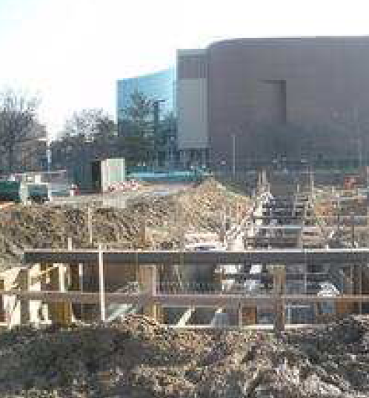
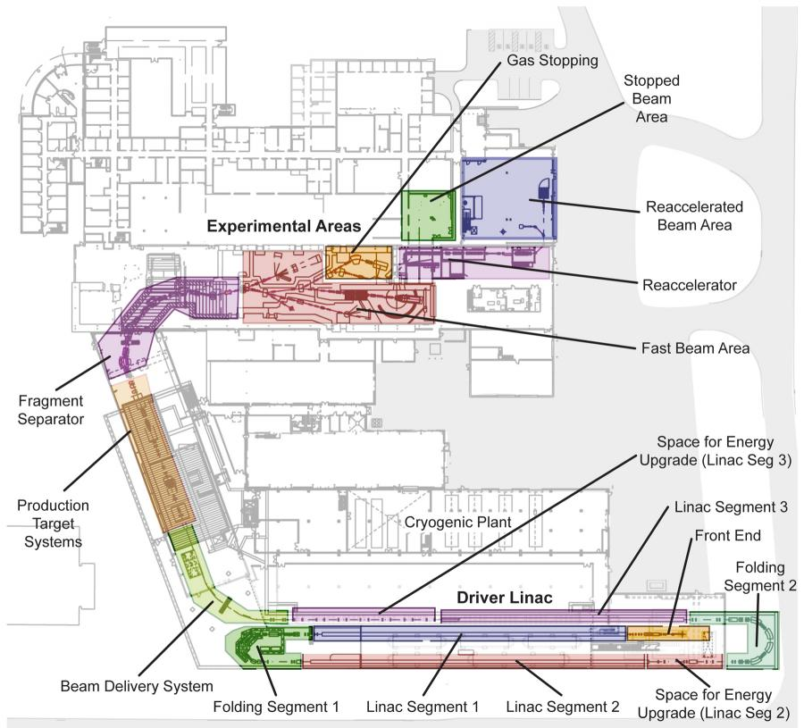
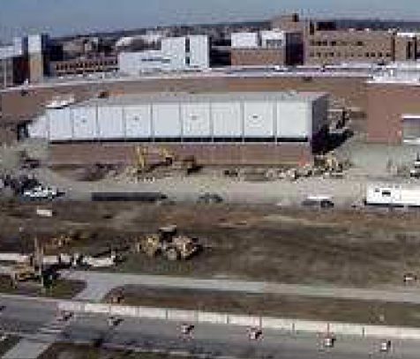
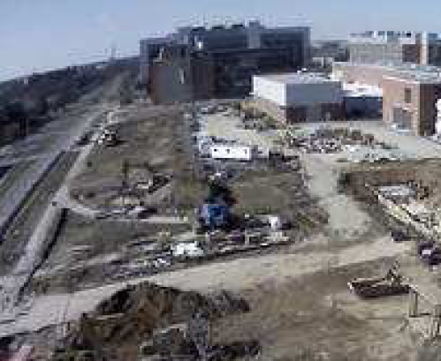
Facility for rare isotope beams FRIB

Slide 4
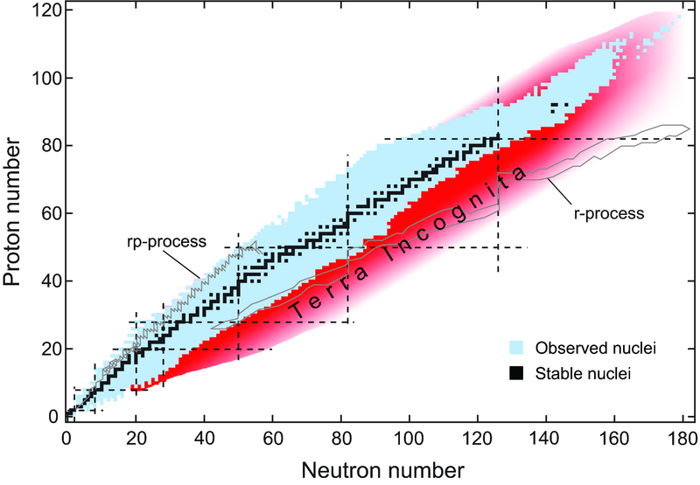
nucleosynthesis in the nuclear chart

Slide 5
what are we after?
Unified description of nuclei and their reactions
Why is matter stable?
Reaction probes
need reliable reaction theory!

Slide 6
reducing the many body to a few body problem
isolating the important degrees of freedom in a reaction
keeping track of all relevant channels
connecting back to the many-body problem
effective nucleon-nucleus interactions (or nucleus-nucleus)
(energy dependence/non-local?)
many body input (often not available)
reliable solution of the few-body problem

Slide 7
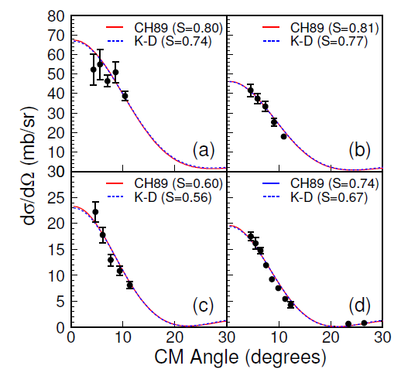
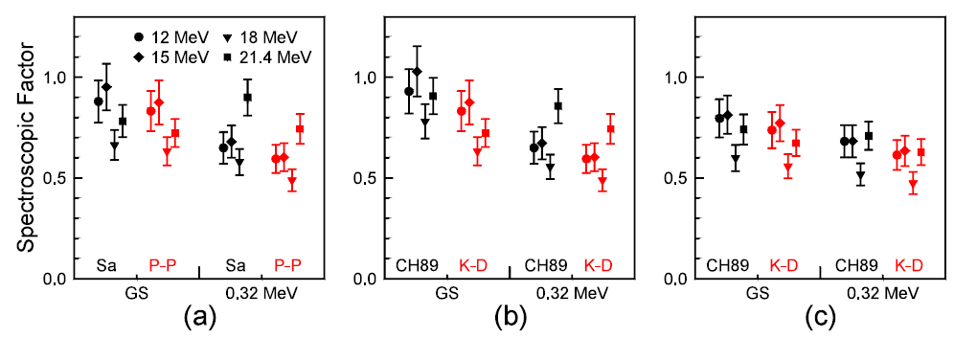
ambiguities in optical potentials
¹⁰Be(d,p)¹¹Be @ 12-21 MeV
DWBA
entrance channel
DWBA
exit channel
ADWA
Schmitt et al, PRL 108, 192701 (2012)

Slide 8

Three classes of theories (Witek’s talk)
3rd rate – theory forbids
2nd rate – theory explains after the fact
1st rate – theory predicts
1st rate – need to know errors!

Slide 9
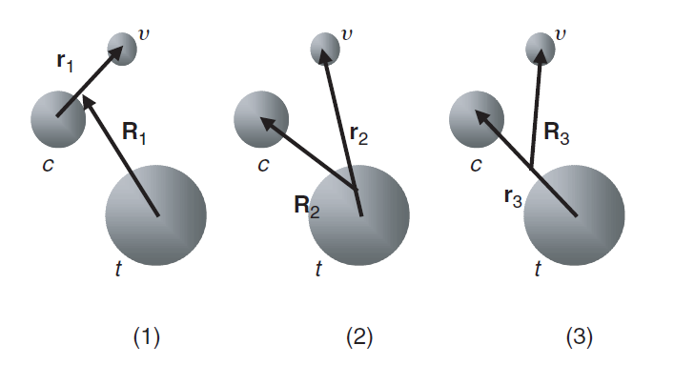
differences between three-body methods
Faddeev AGS:
all three Jacobi components are included
elastic, breakup and rearrangement channels are fully coupled
computationally expensive
Deltuva and Fonseca, Phys. Rev. C79, 014606 (2009).
3 jacobi coordinate sets
CDCC:
only one Jacobi component
elastic and breakup fully coupled (no rearrangement)
computationally expensive
Austern, Kamimura, Rawistcher, Yahiro et al.

Slide 10
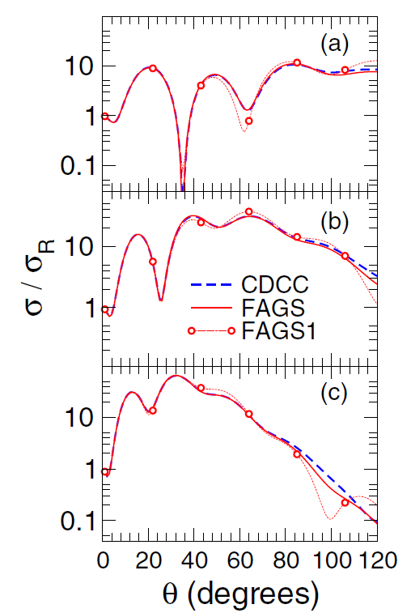
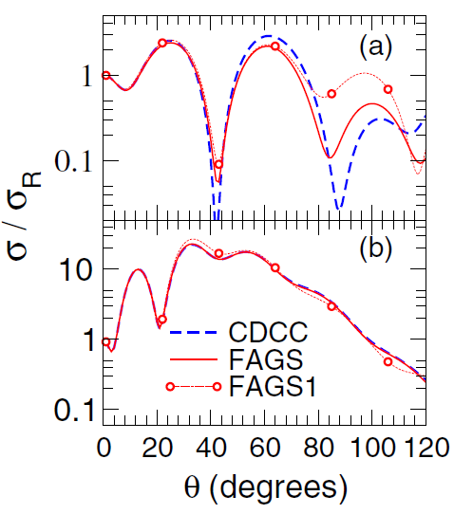
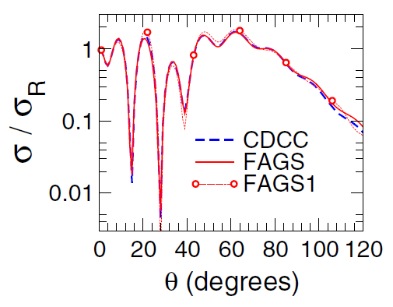
elastic scattering: comparing CDCC with Faddeev
d+¹⁰Be
d+¹²C
21.4 MeV
12 MeV
d+⁴⁸Ca
40.9 MeV
56 MeV
56 MeV
71 MeV
Upadhyay, Deltuva and Nunes, PRC 85, 054621 (2012)

Slide 11
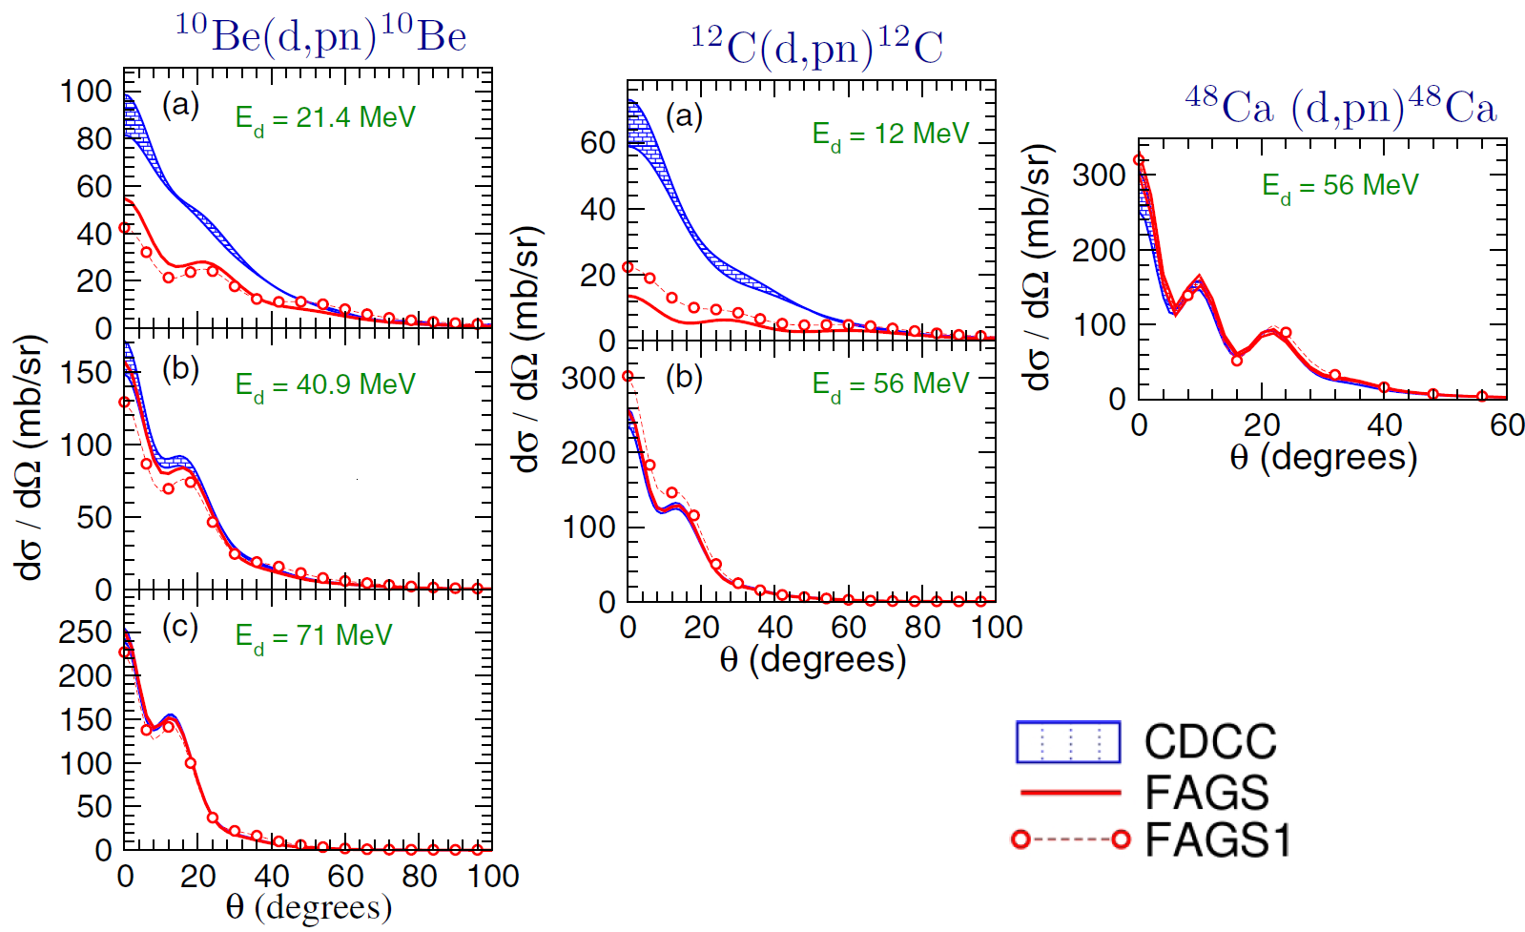
breakup: comparing CDCC with Faddeev
Upadhyay, Deltuva and Nunes, PRC 85, 054621 (2012)

Slide 12
breakup: comparing CDCC with Faddeev
Upadhyay, Deltuva and Nunes, PRC 85, 054621 (2012)

Slide 13
differences between three-body methods
Faddeev AGS:
all three Jacobi components are included
elastic, breakup and rearrangement channels are fully coupled
computationally expensive
Deltuva and Fonseca, Phys. Rev. C79, 014606 (2009).
3 jacobi coordinate sets
CDCC:
only one Jacobi component
elastic and breakup fully coupled (no rearrangement)
computationally expensive
Austern, Kamimura, Rawistcher, Yahiro etc, Prog. Theo. Phys (1986)
ADWA:
only one Jacobi component
elastic and breakup fully coupled (no rearrangement)
adiabatic approximation for breakup
only applicable to obtain transfer cross sections
runs on desktop – practical
Johnson and Tandy NP (1974)

Slide 14
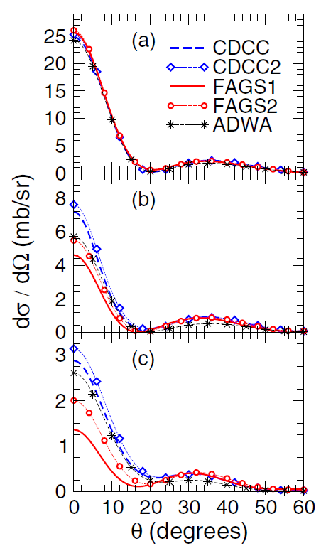
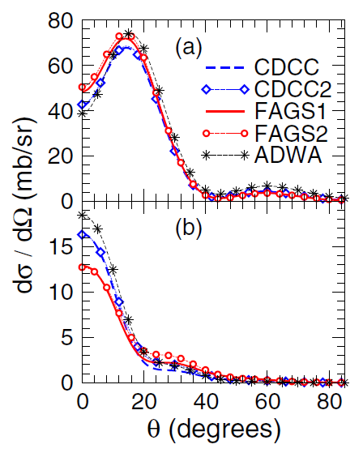
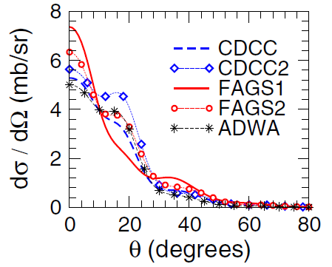
transfer (d,p): comparing ADWA, CDCC & Faddeev
¹⁰Be(d,p) ¹¹Be(g.s.)
¹²C(d,p) ¹²C(g.s.)
12 MeV
21.4 MeV
40.9 MeV
56 MeV
⁴⁸Ca(d,p) ⁴⁸Ca(g.s.)
56 MeV
71 MeV
PRC 84, 034607(2011), PRC 85, 054621 (2012)

Slide 15
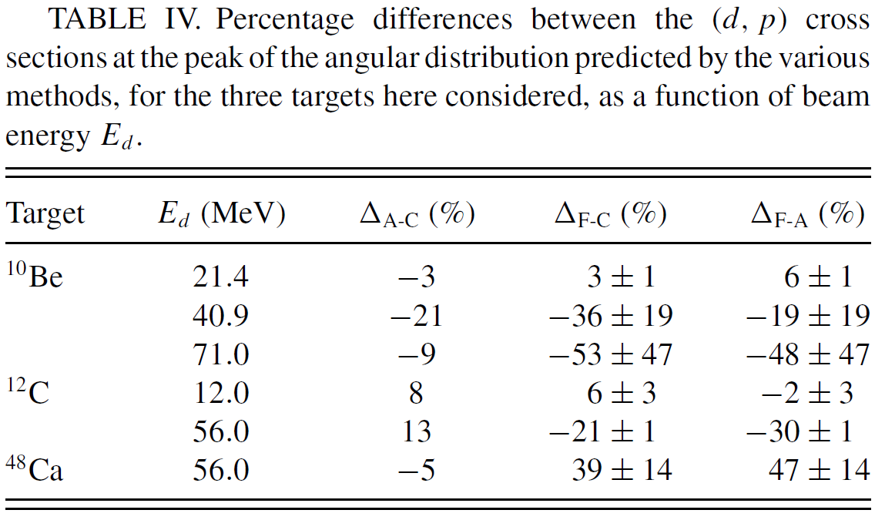
transfer: comparing ADWA, CDCC & Faddeev
Upadhyay, Deltuva and Nunes, PRC 85, 054621 (2012)

Slide 16
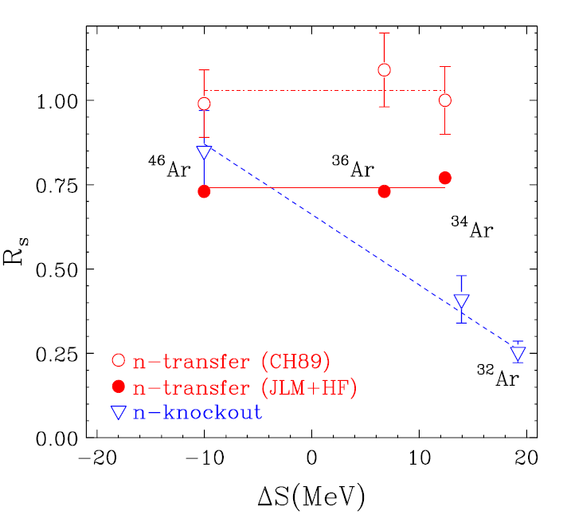
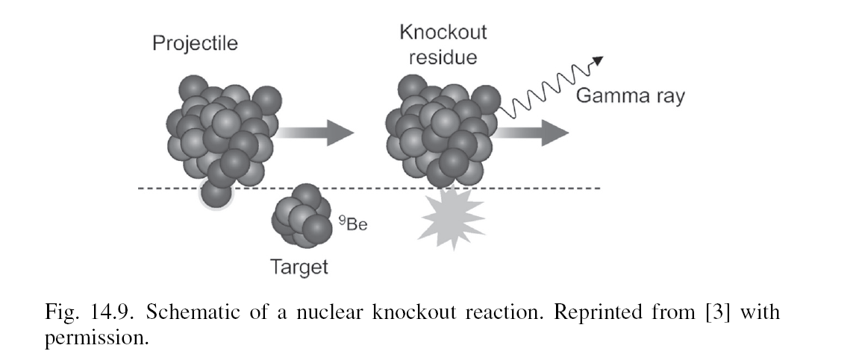
error bar on extracted structure from theory
[Jenny Lee et al, PRL 2009]
[Gade et al, PRL 93, 042501]

Slide 17
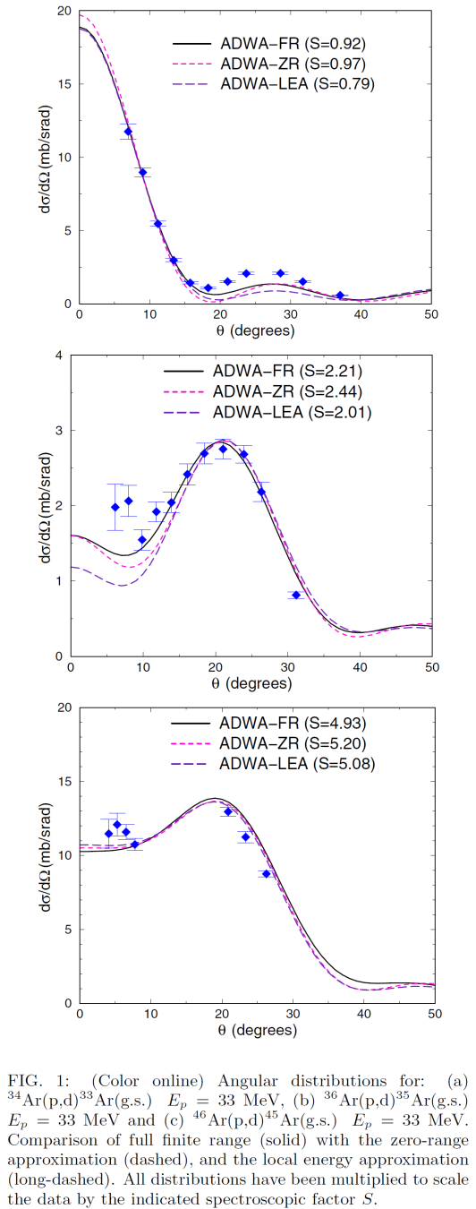
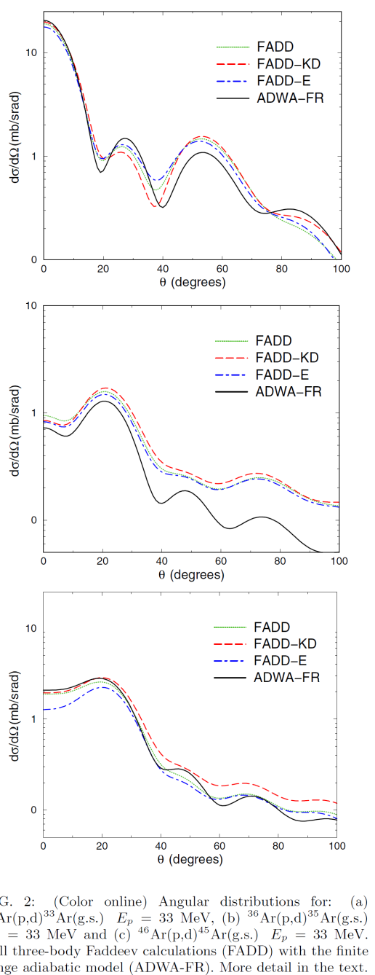
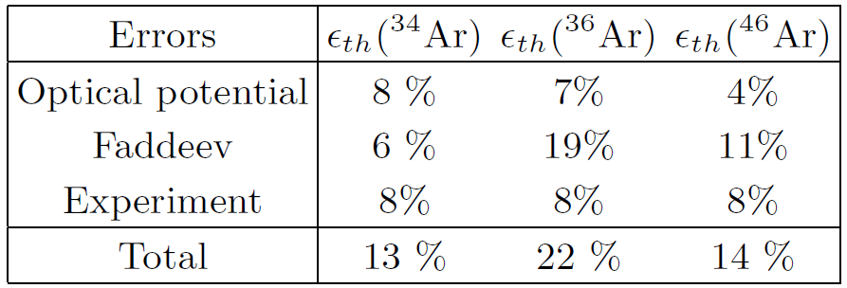
transfer data for Ar isotopes
finite range adiabatic methods are used to obtained spectroscopic factors
Faddeev calculations are used to determined error in reaction theory
[FN, Deltuva, Hong, PRC83, 034610 (2011)]

Slide 18
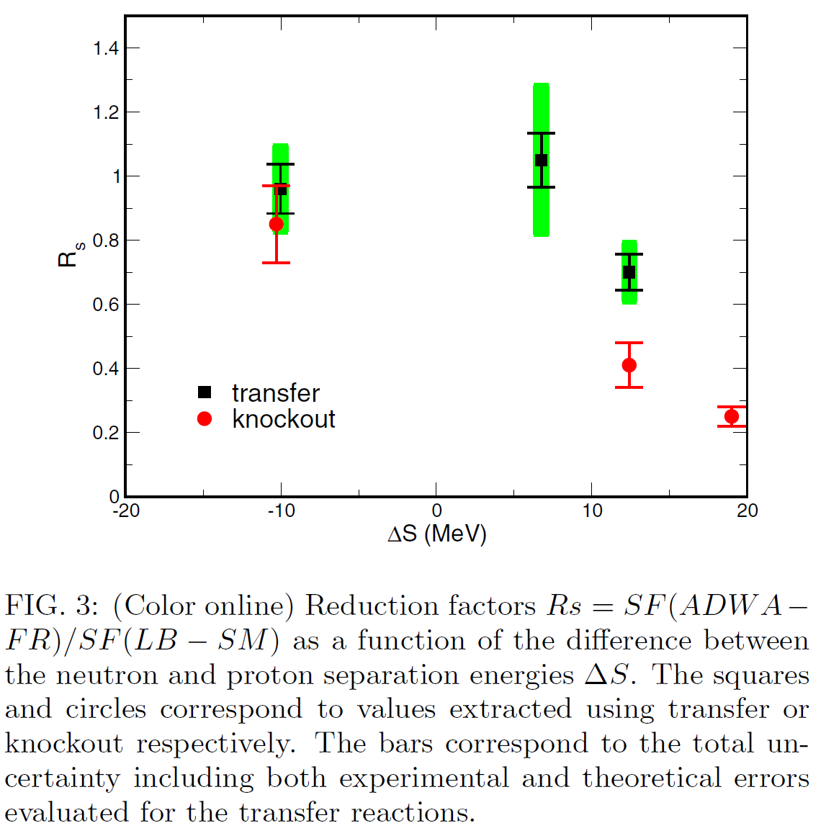
transfer versus knockout
[Jenny Lee et al, PRL 2009]
[Gade et al, Phys. Rev. Lett. 93, 042501]
[FN, Deltuva, Hong, PRC83, 034610 2011]

Slide 19
Conclusions CDCC/ADWA versus Faddeev
Breakup with CDCC (d,pn)
good agreement at E>20 MeV/u
poor convergence at lower energies
CDCC does not describe some configurations
Transfer with ADWA or CDCC (d,p)
good agreement around 10 MeV/u
agreement for ADWA best for l=0 final states
deteriorates with increasing beam energy
ambiguities in optical potentials have larger impact at higher E

Slide 20
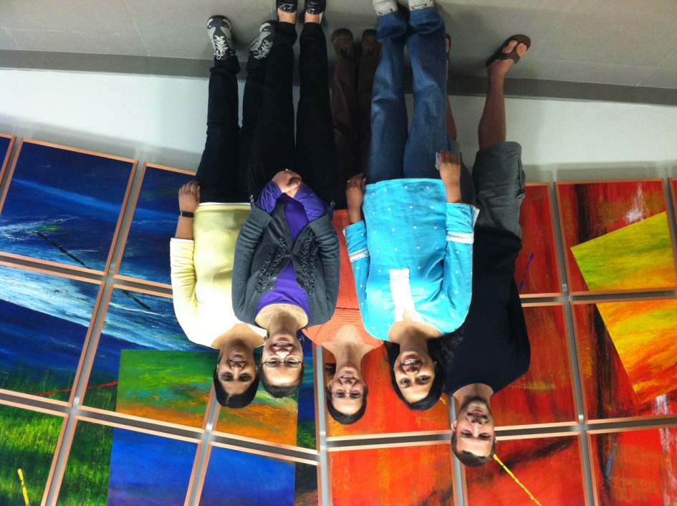

thankyou!
our group at MSU: Ngoc Nguyen, Muslema Pervin,
Luke Titus, Neelam Upadhyay
collaborators:
June Hong(MSU), Arnas Deltuva (Lisbon),
TORUS collaboration: Charlotte Elster (Ohio),
Akram Mukhamedzhanov (Texas A&M),
Ian Thompson (LLNL), Jutta Escher (LLNL)
and Goran Arbanas (ORNL)
Antonio Fonseca (Lisbon),
Ron Johnson and Jeff Tostevin (Surrey),
Happy birthday,
Jerry!
This work was supported by DOE-NT, NNSA and NSF

Slide 22
thankyou!

Slide 23
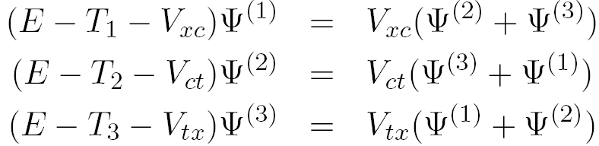
reaction methods: CDCC versus Faddeev formalism
CDCC Formalism
Faddeev Formalism

Slide 24
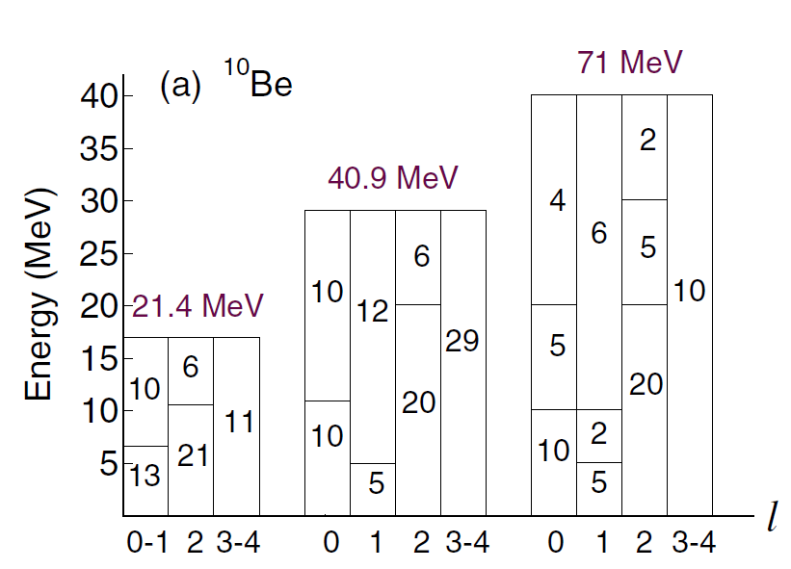
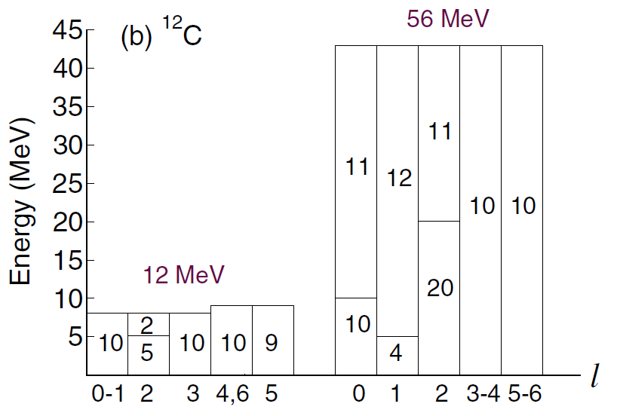
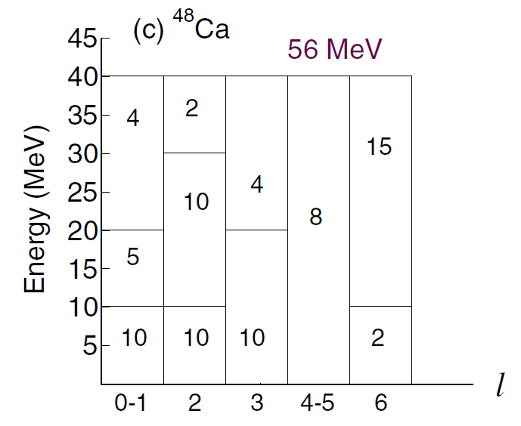
CDCC model space
Upadhyay, Deltuva and Nunes, PRC 85, 054621 (2012)

Slide 25
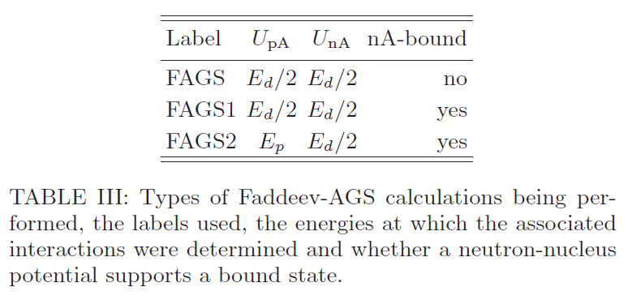
Faddeev calculations: details
Upadhyay, Deltuva and Nunes, PRC 85, 054621 (2012)

Slide 26
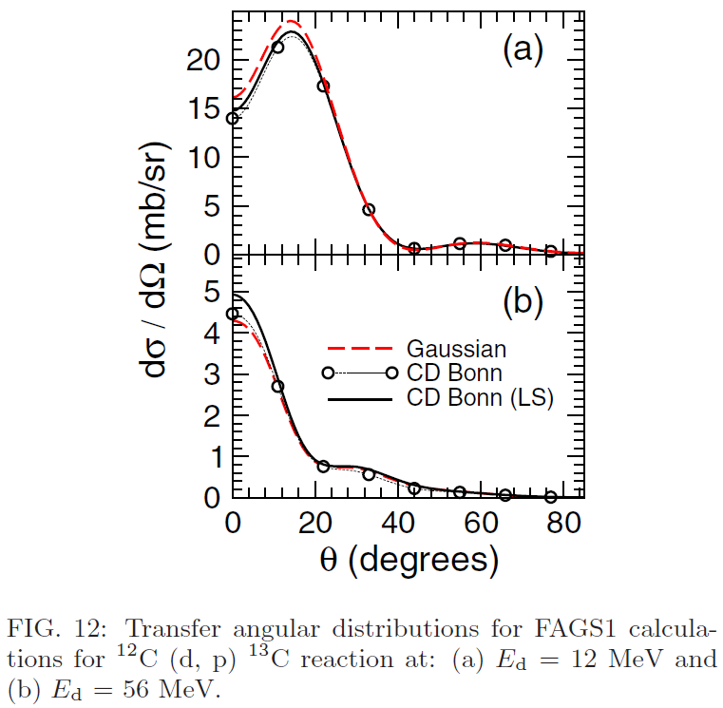
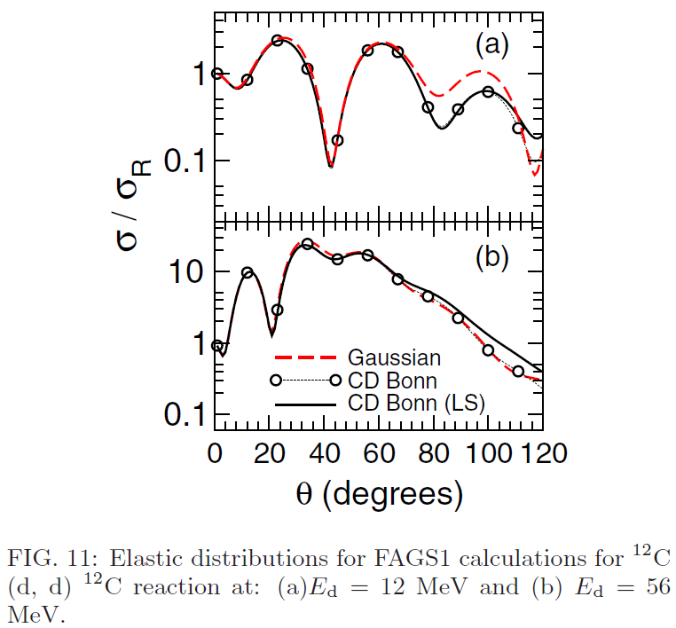
Sensitivity to interactions
At low energies, L dependence of NN interaction important
At high energies, spin-orbit in optical potential important
Upadhyay, Deltuva and Nunes, PRC 85, 054621 (2012)

