Slide 1
Non-local potentials in nuclear reactions
Luke Titus and Filomena Nunes
Michigan State University
DNP, Hawaii 2014

Slide 2
Big science questions
How did matter come into being and how does it evolve?
FRIB theory manifesto, Balantekin et al, MPLA 2014 (arXiv:1401.6435)
Neutron capture on unstable nuclei needed for understanding possible site of r-process: (d,p)/(p,d) reactions offer an indirect tool to extract this information

Slide 3
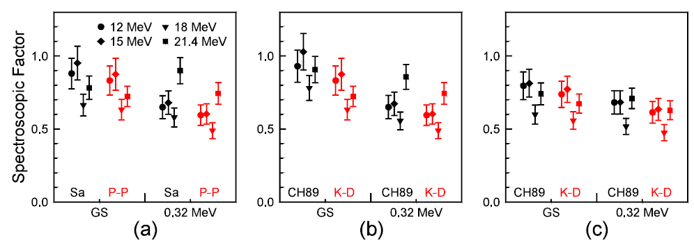
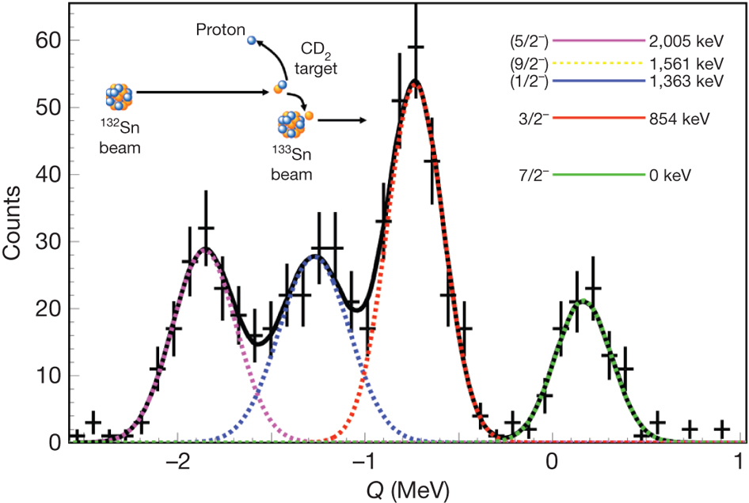
Examples of using (d,p) to study unstable nuclei
Halo nuclei
ADWA
Neutron rich doubly magic nuclei
d(¹³²Sn,¹³³Sn)p@5 MeV/u
¹⁰Be(d,p)¹¹Be @ 12-21 MeV
Schmitt et al, PRL 108, 192701 (2012),
PRC 88, 064612 (2013)
K. Jones et al, Nature 465 (2010) 454, PRC 84, 034601 (2011)

Slide 4
Reaction theory: from many body to few body
isolating the important degrees of freedom in a reaction
connecting back to the many-body problem
effective nucleon-nucleus interactions
(non-local and energy dependent)

Slide 5
Non-local potential?
Phenomenological optical potentials are usually made local U(R)
Microscopically derived optical potentials are non-local U(R,R’)
    Does non-locality make a difference in the reaction?
    Can we constrain non-locality with reactions?

Slide 6
Non-local Perey and Buck potential in (d,p)
Solve the single channel scattering problem with non-local optical potential
Solve the single channel bound state problem with non-local mean field
Construct the (p,d) amplitude within DWBA
Perey and Buck type non-locality
F. Perey and B. Buck, Nucl. Phys. 32, 353 (1962).
Perey correction factor: if the local momentum approximation is valid
N. Austern, Phys. Rev. 137, 752 (1965)

Slide 7
Non-local Perey and Buck potential: effect on (p,d)
Titus and Nunes, PRC 89, 034609 (2014)

Slide 8
Non-local Perey and Buck potential: effect in (p,d)
Titus and Nunes, PRC 89, 034609 (2014)

Slide 9
Dispersive Optical Potential (DOM)
Mahzoon et al, Phys Rev Lett 112, 162503 (2014)

Slide 10
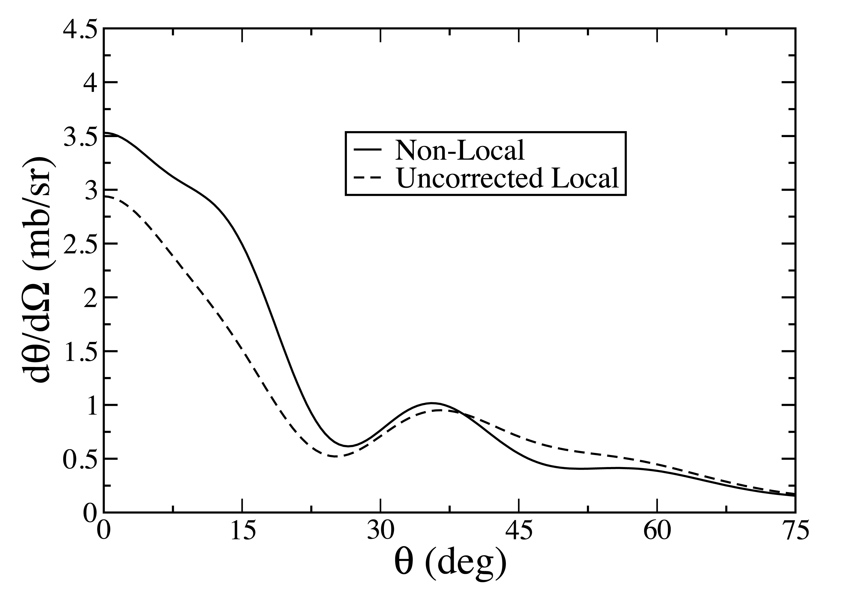
Non-local DOM potential: effect on (p,d)
⁴⁰Ca(p,d)³⁹Ca @ 50 MeV
Potential | Perey-Buck |  | DOM
Energy (MeV) | Non-Local relative to local | Corrected relative to local | Non-Local relative to local
20 | 42 % | 1 % | 21 %
35 | 50 % | 6 % | 32 %
50 | 28 % | 2 % | 20 %
Ross et al., in preparation, SEE REU POSTER

Slide 11
Summary and Outlook
  Impact of non-locality in nuclear reactions
    DWBA tests show strong sensitivity
    to non-locality (20-30% change in cross section)
    need to upgrade best reaction theories to handle non-local interactions
    use state-of-the-art ab-initio methods with correlations to derive non-local optical potentials

Slide 12


thankyou!
Alaina Ross (MSU)
Luke Titus (MSU)
supported by NSF, DOE-NT, NNSA

Slide 13
backup

Slide 14
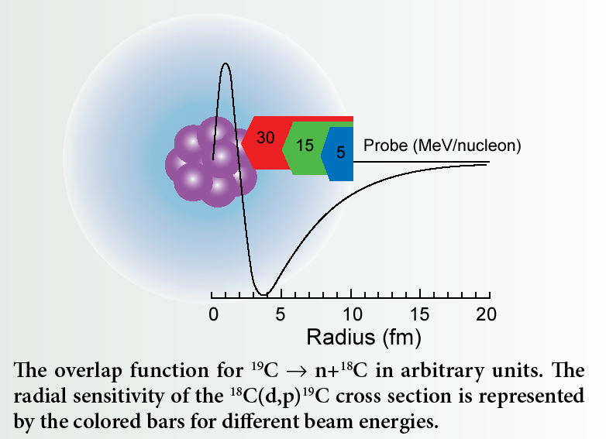
Probing structure through (d,p)
  A(d,p)B reactions probe the overlap function of final nucleus
  angular distributions provide angular momentum of final state
  different beam energies probe different regions of space

